Slide 1

Regular expression
Jan Martinovič
Fakulta elektrotechniky a informatiky
www.fei.vsb.cz
2010

Slide 2
Regular expression
http://www.regularnivyrazy.info/regularni-vyrazy-zaklady.html
C#
  http://msdn.microsoft.com/en-us/library/az24scfc.aspx
Java
  http://java.sun.com/j2se/1.4.2/docs/api/java/util/regex/Pattern.html

Slide 3
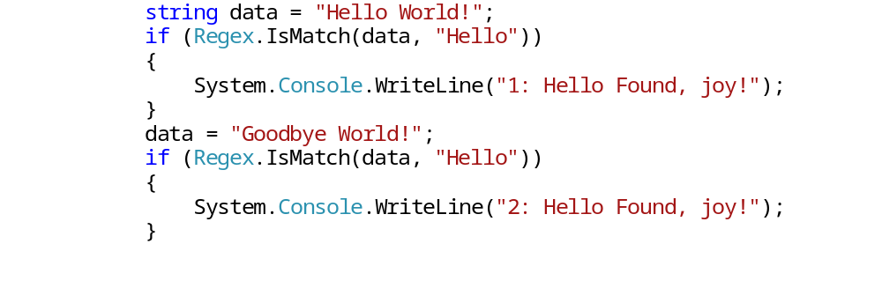
Basic search 1/2
Namespace: System.Text.RegularExpressions
Class: Regex
IsMatch has two prameters:
  The first parameter is a “text”
  The second parameter is a pattern
As the output is boolen value.

Slide 4
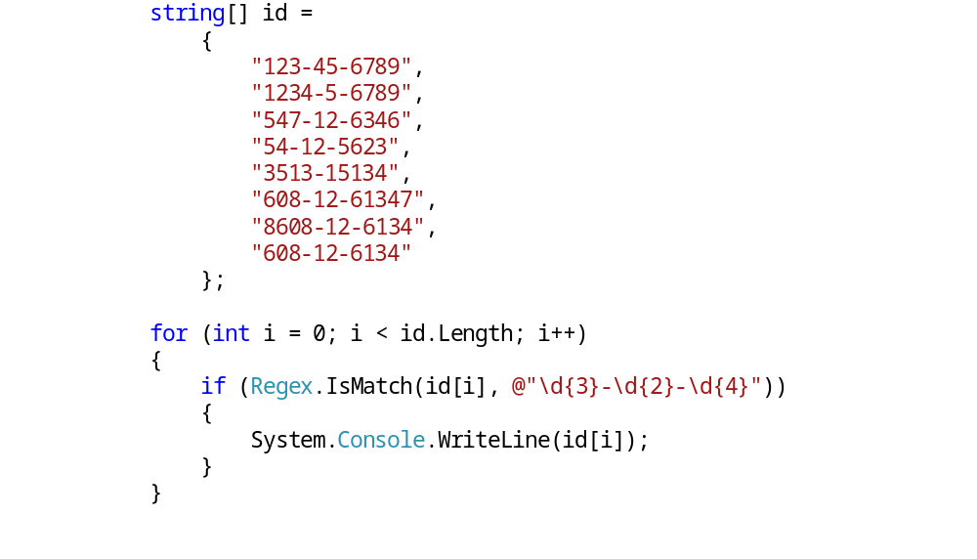
Basic search 2/2
\d{3}-\d{2}-\d{4}
What is the result?
\b\d{3}-\d{2}-\d{4}\b
Ed. 608-12-6134 1

Slide 5
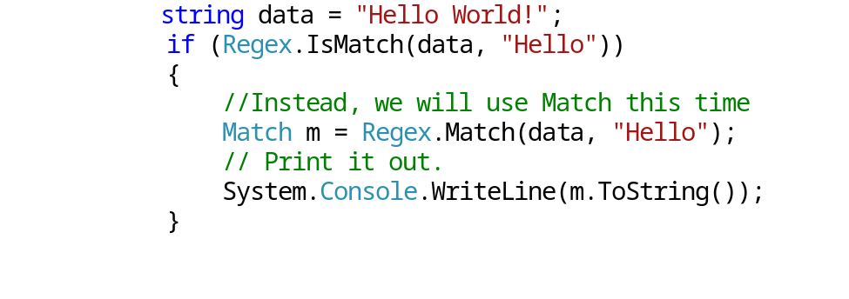
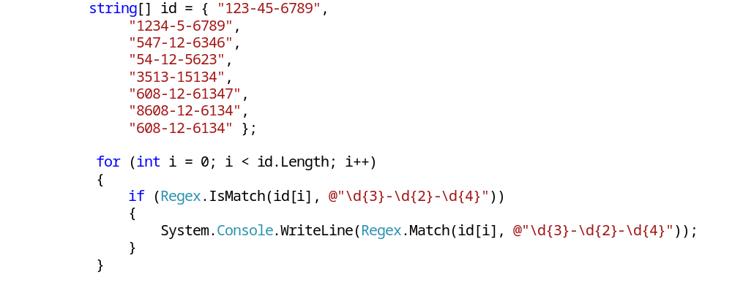
Class Match
Modification of search for numbers

Slide 6
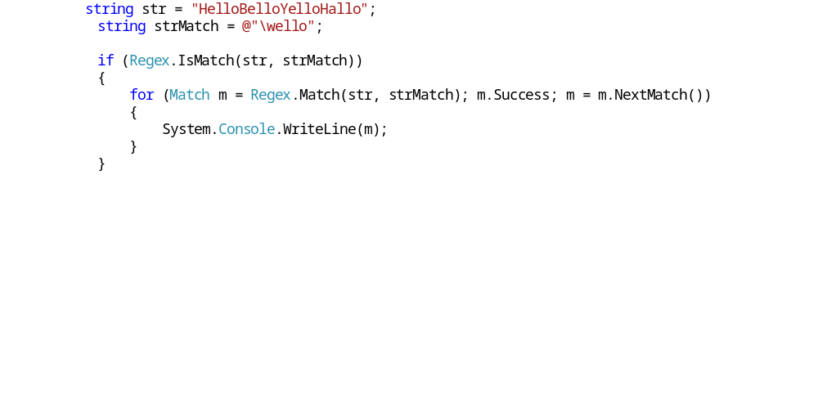
Pass through all occurrences of a pattern

Slide 7
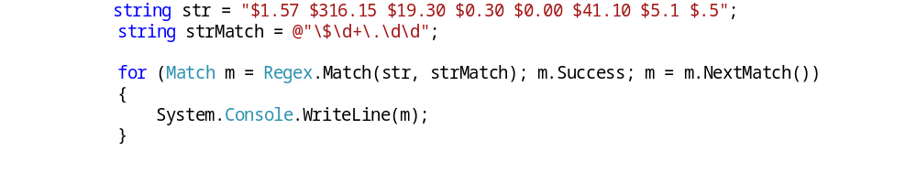
Search $x.yz - $\d+\.\d\d

Slide 8
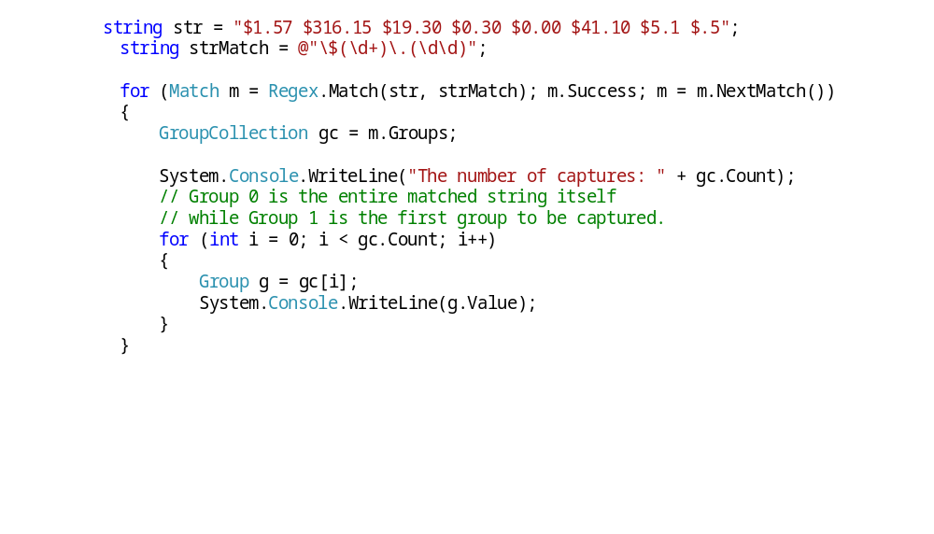
Search $x.yz - $(\d+)\.(\d\d) - Groups

Slide 9
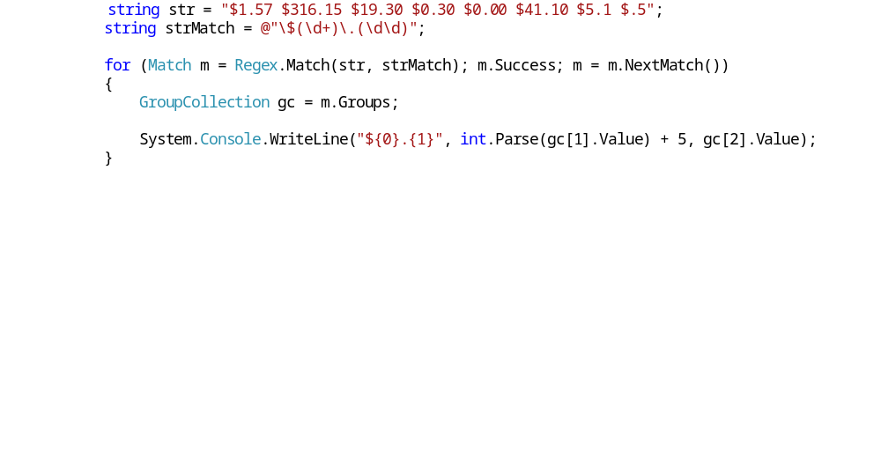
Search $x.yz - $(\d+)\.(\d\d) - Groups

Slide 10
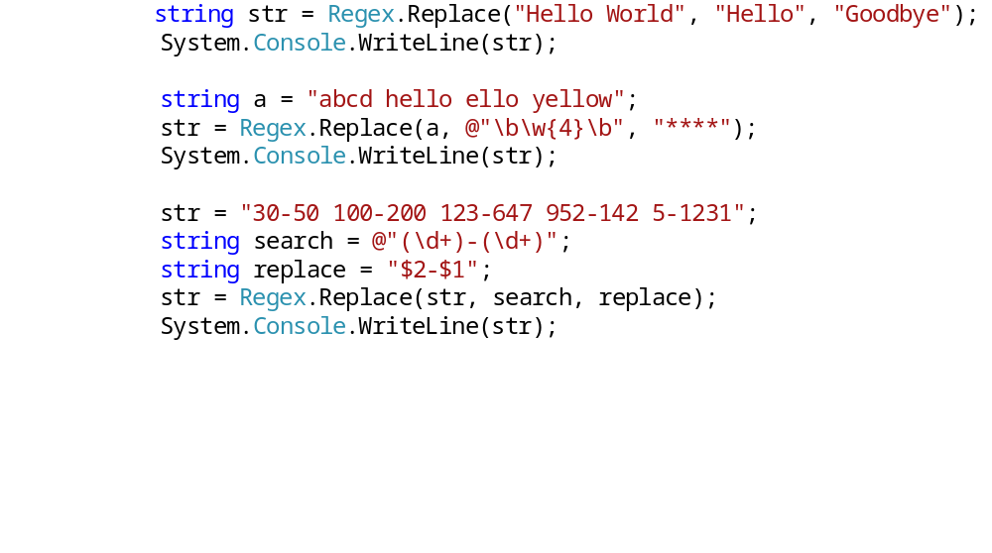
Substituting

Slide 11
Encoding
http://projektysipvz.gytool.cz/ProjektySIPVZ/Default.aspx?uid=814

Slide 12
Literature
Beginning Regular Expressions in C#, Java, and Perl
  http://www.devhood.com/tutorials/tutorial_details.aspx?tutorial_id=523
http://www.vyvojar.cz/Series/10-novinky-v-c-4-a-net-frameworku-4-0.aspx

